Slide 1
1. Docker 설치하기
2. 알약용 image을 Docker에 load 하기
~$> sudo apt-get update
~$> sudo apt-get install apt-transport-https ca-certificates curl gnupg-agent software-properties-common
~$> curl -fsSL https://download.docker.com/linux/ubuntu/gpg | sudo apt-key add -
~$> sudo add-apt-repository "deb [arch=amd64] https://download.docker.com/linux/ubuntu $(lsb_release -cs) stable"
~$> sudo apt-get update
~$> sudo apt-get install docker-ce docker-ce-cli
설치 확인.
~$> sudo docker version
ubuntu@gpu-1:~$ cd proj/proj_pill/proj_docker/
ubuntu@gpu-1:~/proj/proj_pill/proj_docker$ dir
total 4964700
drwxrwxr-x 2 ubuntu ubuntu 4096 Nov 15 15:27 .
drwxrwxr-x 5 ubuntu ubuntu 4096 Nov 15 15:20 ..
-rw-rw-r-- 1 ubuntu ubuntu 5083836928 Nov 15 15:07 pill_class.tar
ubuntu@gpu-1:~/proj/proj_pill/proj_docker$ sudo docker load -i pill_class.tar
824bf068fd3d: Loading layer [==================================================>] 65.51MB/65.51MB
0677e35507df: Loading layer [==================================================>] 3.576GB/3.576GB
dce55ae465d9: Loading layer [==================================================>] 1.326GB/1.326GB
cc1427064650: Loading layer [==================================================>] 116.3MB/116.3MB
Loaded image: ubuntu:pill
ubuntu@gpu-1:~/proj/proj_pill/proj_docker$ sudo docker images
REPOSITORY TAG IMAGE ID CREATED SIZE
ubuntu pill 8d50ddab7868 45 minutes ago 4.96GB
ubuntu@gpu-1:~/proj/proj_pill/proj_docker$

Slide 2
3. 알약용 docker image을 실행하기
~$> ubuntu@gpu-1:~/proj/proj_pill/proj_docker$ sudo docker run -it -v /home/ubuntu/proj/proj_pill:/home/ubuntu/proj/proj_pill ubuntu:pill
(base) root@7cce986fb0b5:/#
Docker 내부의 작업위치
Docker와 연결된 외부 directory
외부 director에 py file과 시험할 이미지가 있음.
(3page 참조 )
4. 알약 class 0 에 대해 estimate해보기
(base) root@7cce986fb0b5:/# cd /home/ubuntu/proj/proj_pill/proj_pill
(base) root@7cce986fb0b5:/home/ubuntu/proj/proj_pill/proj_pill# python main_cls0.py
job=resnet152 run_phase:test aug_level:0, dataclass:0
BATCH_SIZE:8, num_workers:4, num_threads:2
model_path_in is /home/ubuntu/proj/proj_pill/proj_pill/pill_resnet152_dataclass0_aug0.pt
dataset dir is /home/ubuntu/proj/proj_pill/pill_data/pill_data_croped/pill_class_list.json
run_phase is test, aug_level is 0
gen_type is read_only_image, loading data ...
label_path was loaded from <<< pngfile_class0_test >>>
data loading done. dataset'length is 64740
valid dataset was loaded
dataset loading time is 1.5846672058105469
optimizer was selected as type:sgd
model_path will be loaded from:/home/ubuntu/proj/proj_pill/proj_pill/pill_resnet152_dataclass0_aug0.pt
model was loaded from state
resnet152 aug_level:0 :test Epoch #0: 0%| | 14/8093 [00:48<7:43:26, 3.44s/it, loss=0.00693, top1=100, top5=100]
알약 class 1 에 대해 estimate 하려면,
‘python main_cls1.py’
주의: 1. 사용되는 docker image은 GPU을 지원하지 않음.
2. docker은 시험환경만 제공하고, 내부에 source code와 이미지를 포함하지 않는다(외부 연결 사용).

Slide 3
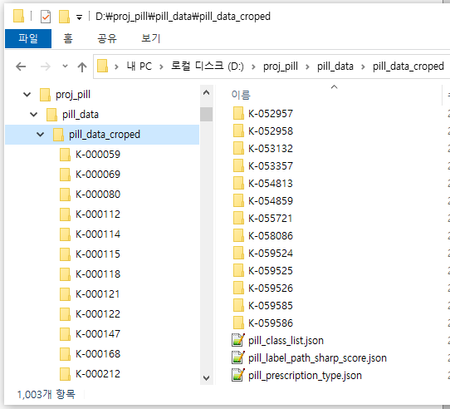
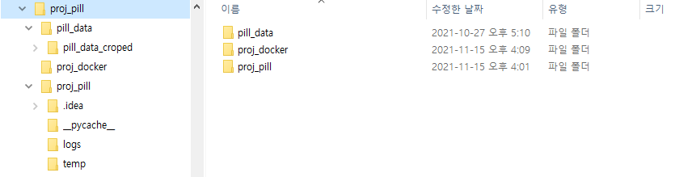
5. Pill project 폴더 구조 ( docker와 연결된 외부 작업 directory 구조).
Pill project 구조에는 3개의 폴더가 있다.
- pill_data/pill_data-croped : 224x224 알약 이미지가 directory로 분류되어 있다.
. pill_label_path_sharp_score.json : Pill ID와 Label 정보를 포함함.
. pill_class_list.json : Pill을 class0, class1으로 분류하고, 세부적으로 Train, Validation, Test 용으로 나누어져 있다.( 4page 참조 )
- proj_docker/pill_class.tar : docker 이미지가 있다.
- proj_pill : 필요한 py 파일들이 있다.

Slide 4
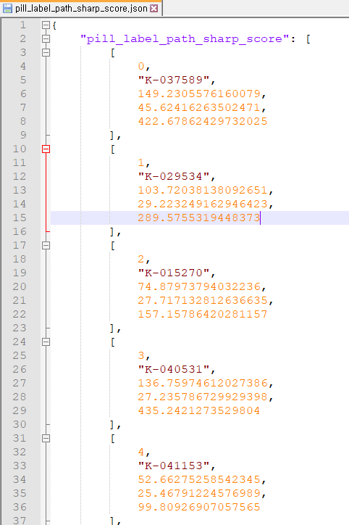
6. Json 파일 내부 구조.
pill_label_path_sharp_score.json : Pill ID 와 Label
pill_class_list.json : 시험할 이미지 list
{
"pngfile_class0_train": [
"/home/ubuntu/proj/proj_pill/pill_data/pill_data_croped/K-026788/K-026788_0_0_0_2_90_240_200.png", "/home/ubuntu/proj/proj_pill/pill_data/pill_data_croped/K-046428/K-046428_0_2_0_2_75_340_200.png", "/home/ubuntu/proj/proj_pill/pill_data/pill_data_croped/K-001438/K-001438_0_0_1_0_75_140_200.png",
…
"pngfile_class0_valid": [
"/home/ubuntu/proj/proj_pill/pill_data/pill_data_croped/K-046428/K-046428_0_2_0_1_90_140_200.png", "/home/ubuntu/proj/proj_pill/pill_data/pill_data_croped/K-046428/K-046428_0_1_0_0_90_220_200.png", "/home/ubuntu/proj/proj_pill/pill_data/pill_data_croped/K-001728/K-001728_0_2_1_0_90_020_200.png",
…
"pngfile_class0_test": [
"/home/ubuntu/proj/proj_pill/pill_data/pill_data_croped/K-052619/K-052619_0_2_0_2_75_140_200.png", "/home/ubuntu/proj/proj_pill/pill_data/pill_data_croped/K-006250/K-006250_0_1_0_1_75_000_200.png", "/home/ubuntu/proj/proj_pill/pill_data/pill_data_croped/K-038576/K-038576_0_0_0_2_75_120_200.png",
…
"pngfile_class1_train": [
"/home/ubuntu/proj/proj_pill/pill_data/pill_data_croped/K-044085/K-044085_0_0_1_1_70_340_200.png", "/home/ubuntu/proj/proj_pill/pill_data/pill_data_croped/K-009458/K-009458_0_2_0_0_60_240_200.png", "/home/ubuntu/proj/proj_pill/pill_data/pill_data_croped/K-023720/K-023720_0_1_1_2_60_060_200.png",
…
"pngfile_class1_valid": [
"/home/ubuntu/proj/proj_pill/pill_data/pill_data_croped/K-024752/K-024752_0_2_1_2_60_320_200.png", "/home/ubuntu/proj/proj_pill/pill_data/pill_data_croped/K-037589/K-037589_0_2_0_2_70_140_200.png", "/home/ubuntu/proj/proj_pill/pill_data/pill_data_croped/K-037589/K-037589_0_2_1_2_60_180_200.png",
…
"pngfile_class1_train": [
"/home/ubuntu/proj/proj_pill/pill_data/pill_data_croped/K-037043/K-037043_0_2_0_1_60_080_200.png", "/home/ubuntu/proj/proj_pill/pill_data/pill_data_croped/K-018254/K-018254_0_2_1_0_70_200_200.png", "/home/ubuntu/proj/proj_pill/pill_data/pill_data_croped/K-005949/K-005949_0_0_1_0_60_260_200.png",
…
}

